Slide 1
INTERACTION STYLES
SAMEER KHOWAJA
19SW49

Slide 2
INTERACTION STYLES
Interaction styles are primarily different ways in which a user and computer system can communicate between each other

Slide 3
INTERACTION STYLES
Command Line
Natural Language
Menu Selection
Form Fill-in
Question Answer Interfaces

Slide 4
Command line
First interaction style to be commonly used.
Command must be remembered, No hint is provided in command line to indicate which command is needed.
Provide instruction to computer directly using:
Abbreviations (e.g. cd, ftp)
Single character
Function key
Whole word
Combination of the above

Slide 5
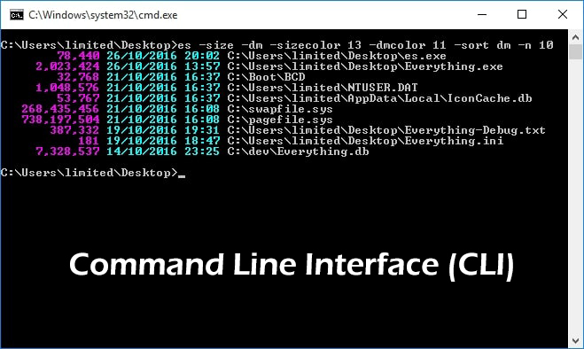
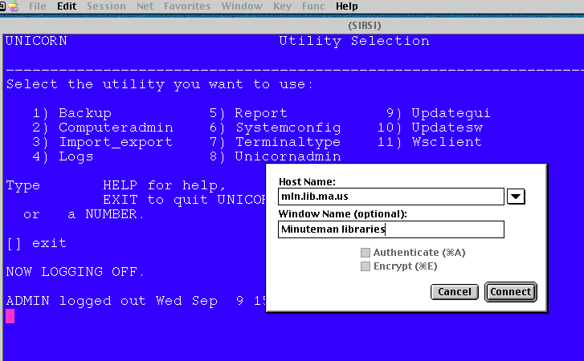
Command line

Slide 6
Command line
Advantages | Disadvantages
Flexible Appeals to ‘power users’ Supports user initiative Allow convenient creation of macros | Poor error handling Substantial training and memorization

Slide 7
Natural language
A natural language interface is a user interface in which the user and the system communicate via a natural (human) language. The user provides input as sentences via speech or some other input, and the system generates responses in the form of sentences delivered by speech, text or another suitable modality.

Slide 8
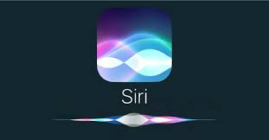
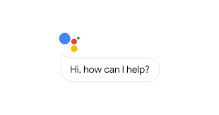
Natural language

Slide 9
Natural language
Advantages | Disadvantages
User do not have to learn the syntax or principles of a particular language Can provide a safer interface in certain environment – Example: Driving a car | A voice interface might need training to get the software to recognize what the user is saying Misinterpretation due to ambiguous or unclear input.

Slide 10
MENU SELECTION
In menu based interfaces, the user is presented with a list of options or most time, icons, each of which is mapped to a certain functionality, another screen or a submenu.
The user chooses a option or a series of options from the given list until the desired task is performed.

Slide 11
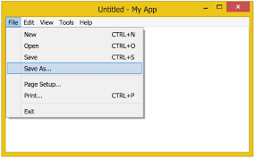
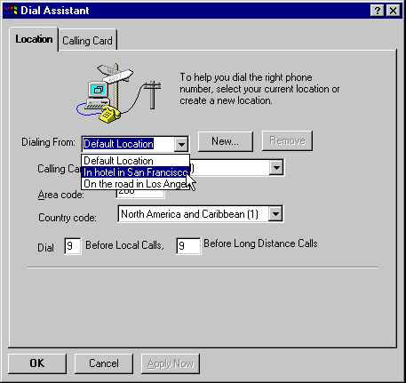
MENU SELECTION

Slide 12
MENU SELECTION
Advantages | Disadvantages
Easy to use There are no commands to remember Even if you don’t know what to do, you can usually guess your way around the options | A poorly designed menu interface may be slow to use It can be irritating if there are too many screens to work through. If menu is poorly designed it might be hard to read

Slide 13
Form Fill-in
Form-fill interfaces consist of onscreen forms or Web-based forms displaying fields containing data items or parameters that need to be communicated to the user.
The form often is a facsimile of a paper form already familiar to the user
Forms for display screens are set up to show what information should be input and where. Blank fields requiring information can be highlighted with inverse or flashing characters.

Slide 14
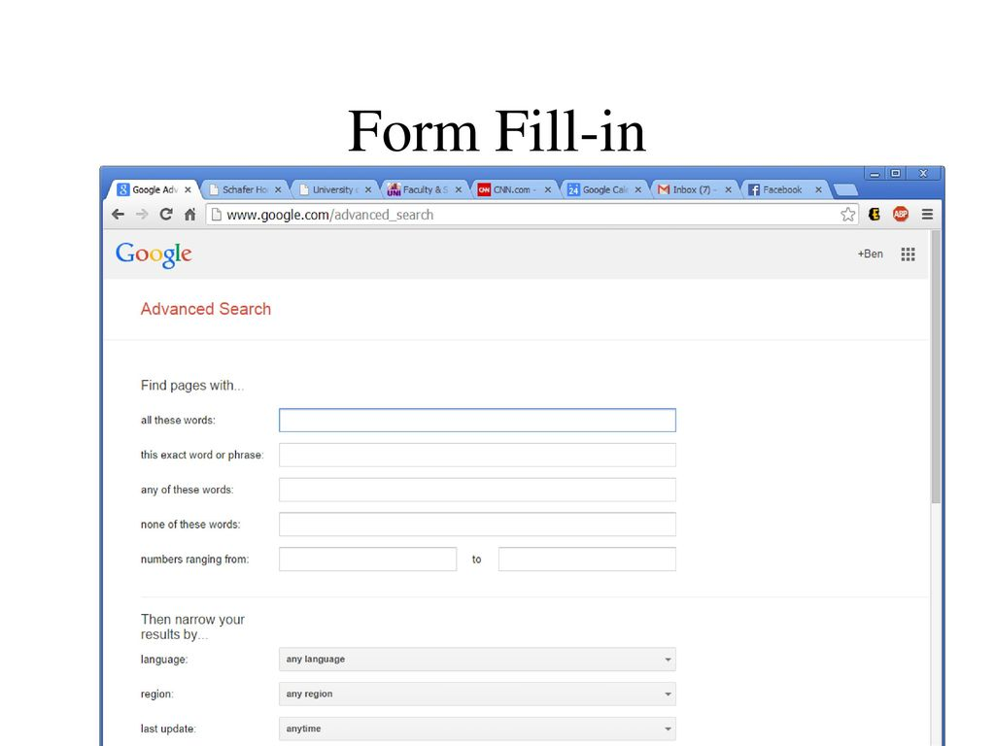
Form Fill-in

Slide 15
Form Fill-in
Advantages | Disadvantages
Low memory requirements Self-explanatory Can gather a great deal of information in little space | Require valid input in valid format Require familiarity with interface controls Can be tedious to correct mistakes

Slide 16
Question answer
In a question-and-answer interface, the computer displays a question to the user on the display. To interact, the user enters an answer (via a keyboard stroke or a mouse click), and the computer then acts on that input information in a preprogrammed manner, typically by moving to the next question.

Slide 17
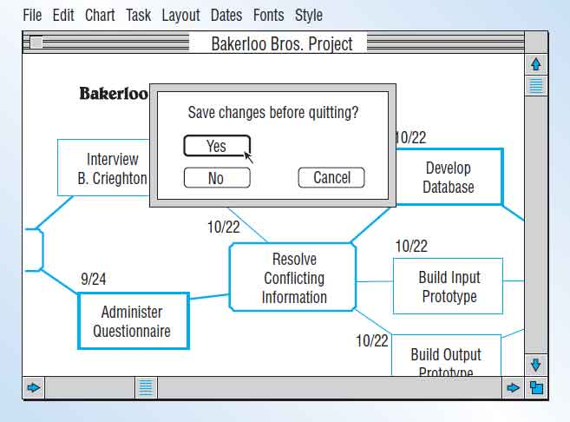
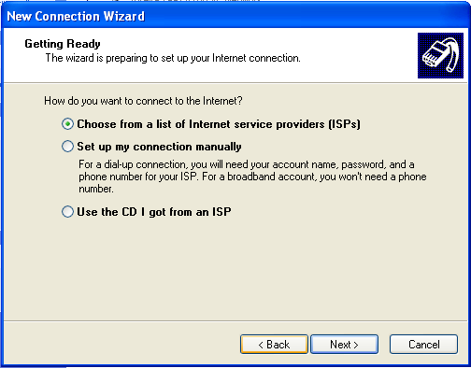
Question answer

Slide 18
Question answer
Advantages | Disadvantages
Low memory requirement Self-explanatory Simple linear presentation Easy for beginners | Require valid input supplied by user Require familiarity with interface controls.

Slide 19
THANKYOU!!

